Slide 1
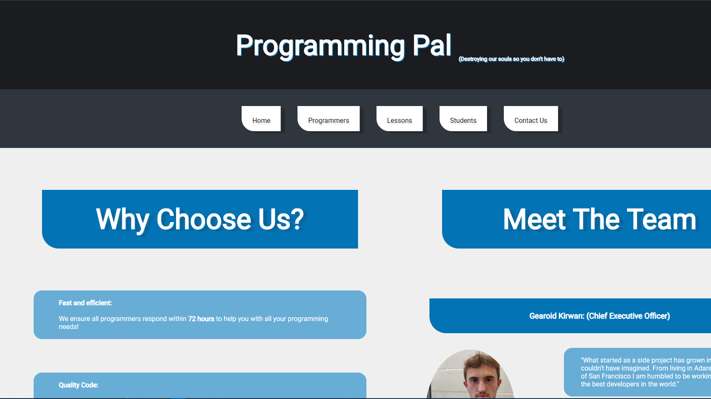
Programming Pal Website
Luke O’Sullivan Griffin/Mike Vriesema

Slide 2
Programming PAL
We chose the concept of a programming pal hire/teaching system as the fundamental base for our company.
If this was a real company, it would be a very useful service to struggling computer science students.
The company would provide services that allow you to hire a programmer in a particular language at a set rate to design an application or hire a programmer to assist in the teaching and learning of new skills in a chosen programming language or from scratch.

Slide 3

Homepg
Index.php
HTML/CSS

Slide 4
HTML/CSS
We decided to go for a simple design approach with minimalistic colours (shades of grey, white and blue).
The header consists of a h1 heading and a subscript for smaller text.
The nav bar is located underneath with customised links to each webpage.
The main body is split into two divs (content and content 2), allowing us to easily place content on either side of the page. The divs are identified in the stylesheet using ID’s and Classes where appropriate.
A footer is included which includes the address, a mailto link and links to other pages (for ease of access).

Slide 5
HTML/CSS
Two stylesheets were created: indexStyle.css and formStyle.css.
IndexStyle is used as the main template. FormStyle is used for pages that contain forms.
We decided to do this as it reduced clutter and made it far easier to adjust certain elements without affecting other pages without forms.

Slide 6
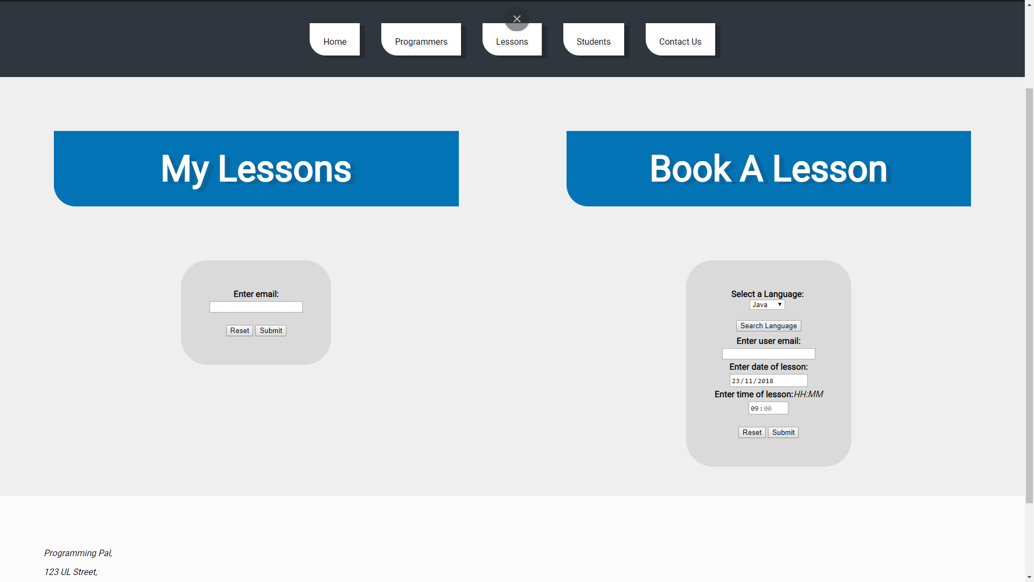
Homepg
form.php
HTML/CSS

Slide 7
HTML/CSS
Two stylesheets were created: indexStyle.css and formStyle.css.
IndexStyle is used as the main template. FormStyle is used for pages that contain forms.
We decided to do this as it reduced clutter and made it far easier to adjust certain elements without affecting other pages without forms.

Slide 8
PHP STUFF
You only need about 3 or 4 decisions to make an A.I function/perform basic tasks.
However a lot of time is needed to try and create a very effective strategy .
Working with an extra person helps you to create something more ambitious than if you were working on your own and also allows for the sharing of ideas.
An example of another SIB we were hoping to implement was “boardAfterPlacing” which allows the A.I to see the outcome of placing an atom before physically placing it on the board.
This would allow the A.I to plan ahead making it much more sophisticated.

Slide 9
In conclusion…

Slide 10
